Slide 1


Slide 2

Money. You need it to do anything
How you handle it can enslave or set you free. In this lesson, we are going to delve into one of the most important topics for business owners— really for anyone. Your personal financial management, literacy, and habits will impact your business finances.

Slide 3


Slide 4

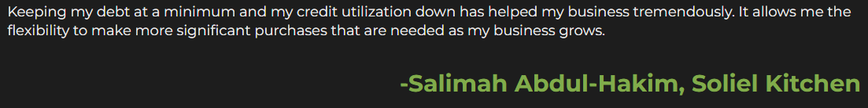

Slide 5
Survey
Take a moment to think back to the first time that you were introduced to the concept of money…
What did your family, friends, teachers, religious institutions, or anyone
else teach you about money?
What is your most difficult challenge in handling money?
Submit your assignment
You may only submit one file with maximum 100 MB in size
On a scale of 1-5, how would you rate your financial position today?

Slide 6
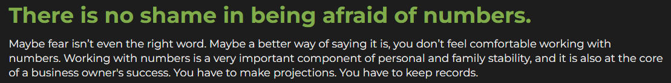



Slide 7

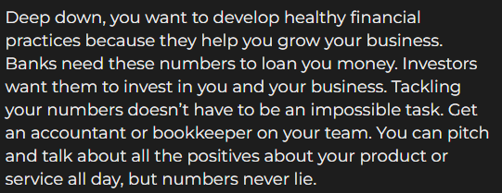

Slide 8

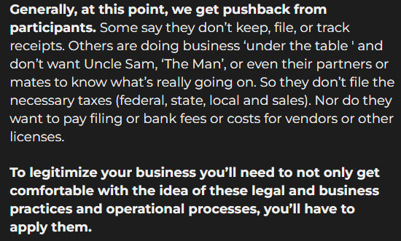

Slide 9
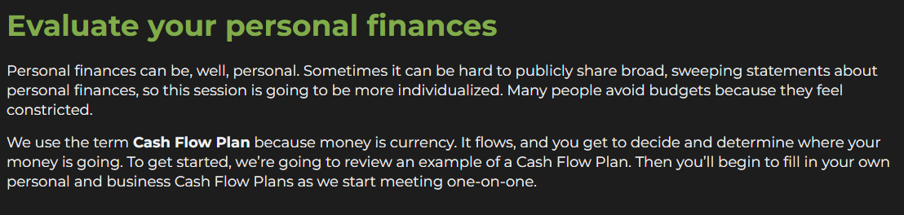

Slide 10
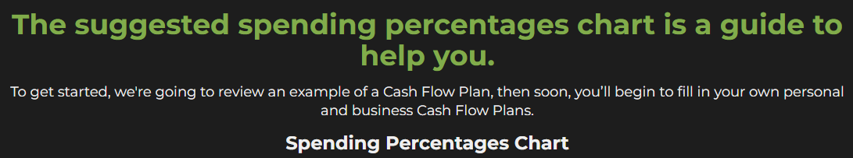
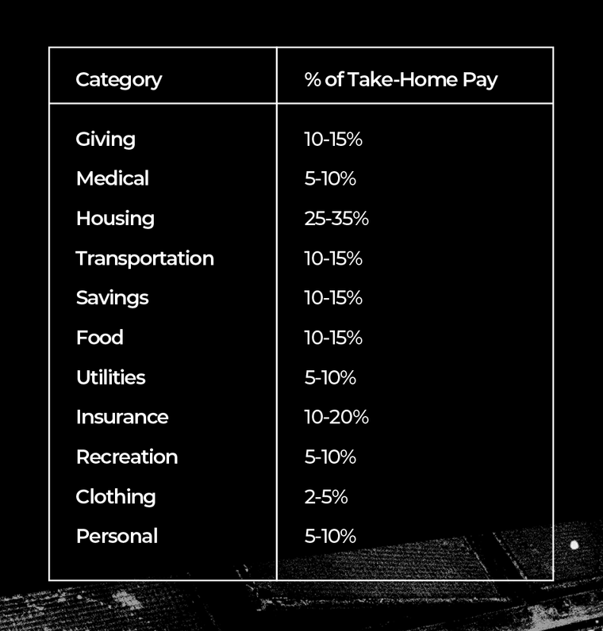

Slide 11


Slide 12
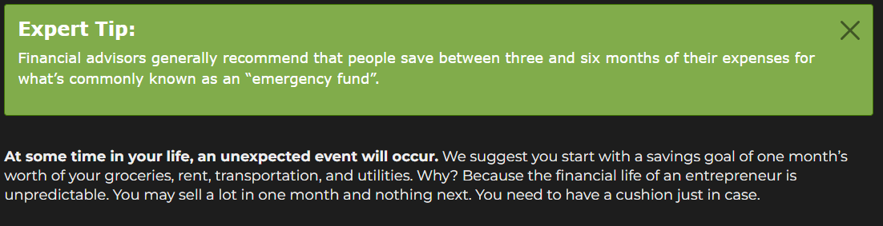

Slide 13
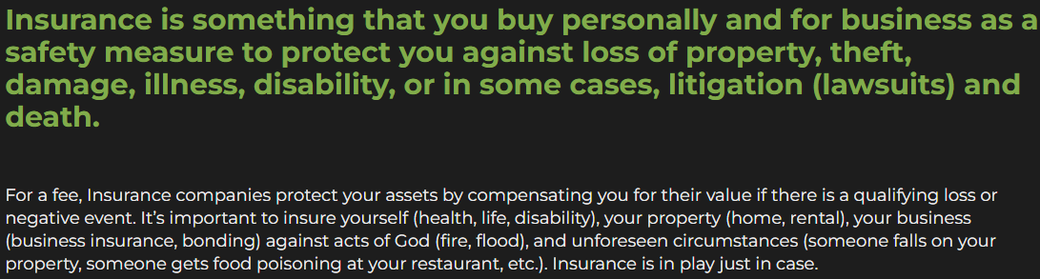
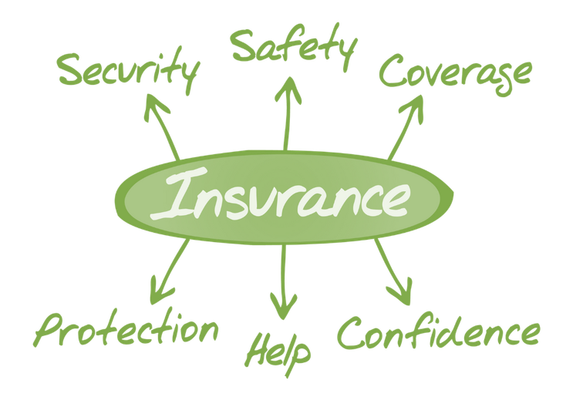

Slide 14
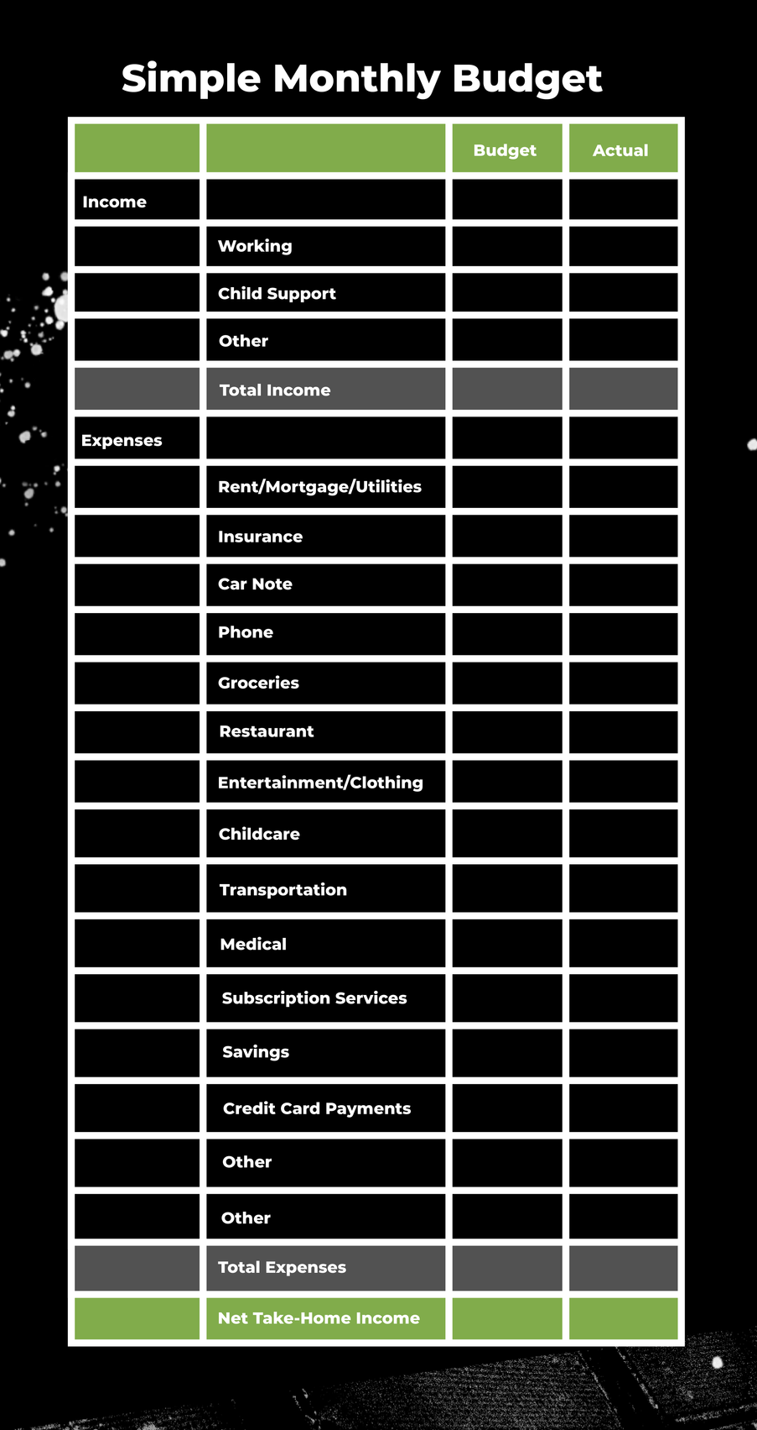
Survey

Slide 15
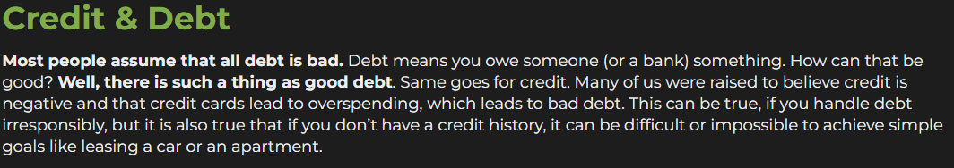
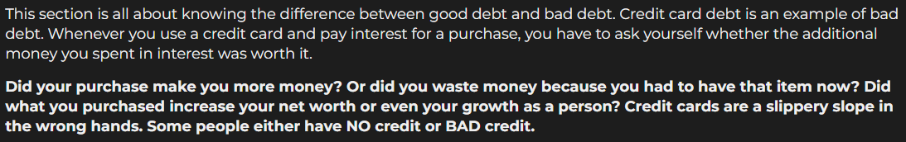

Slide 16


Slide 17


Slide 18
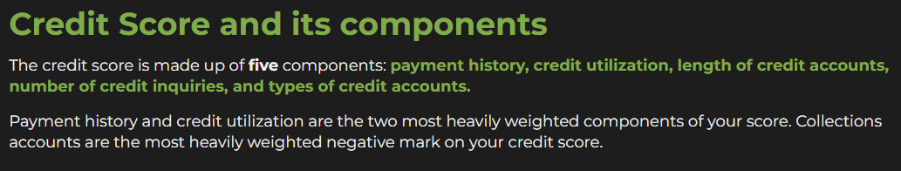
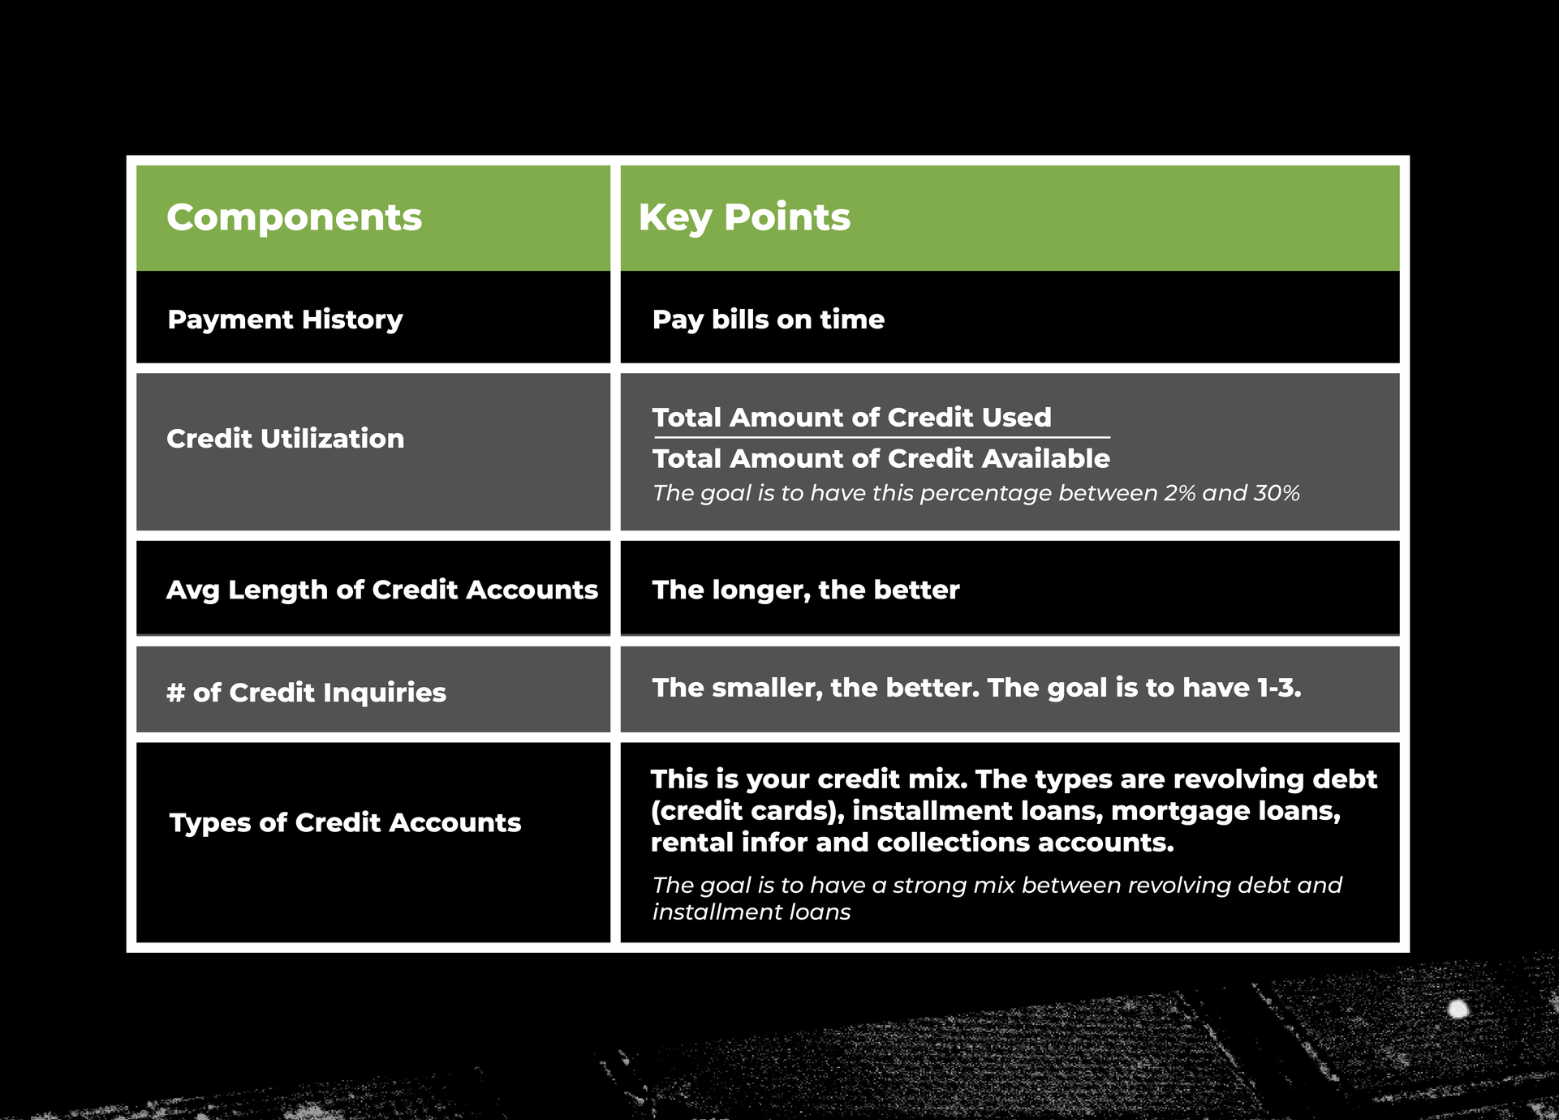

Slide 19
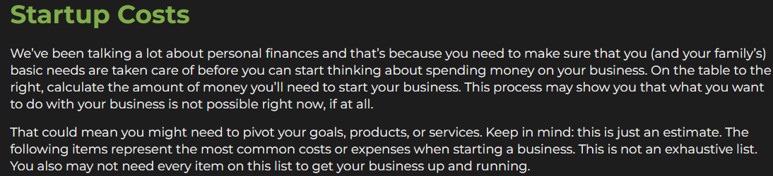

Slide 20
Survey
Consider only the most essential costs for your business. Consult your peers, look up information online, and/or talk through your process with your mentor or accountant to ensure you’re on the right track. Click the button below to download and complete the exercise.

Slide 21
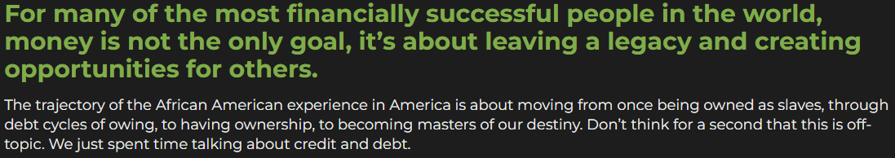

Slide 22
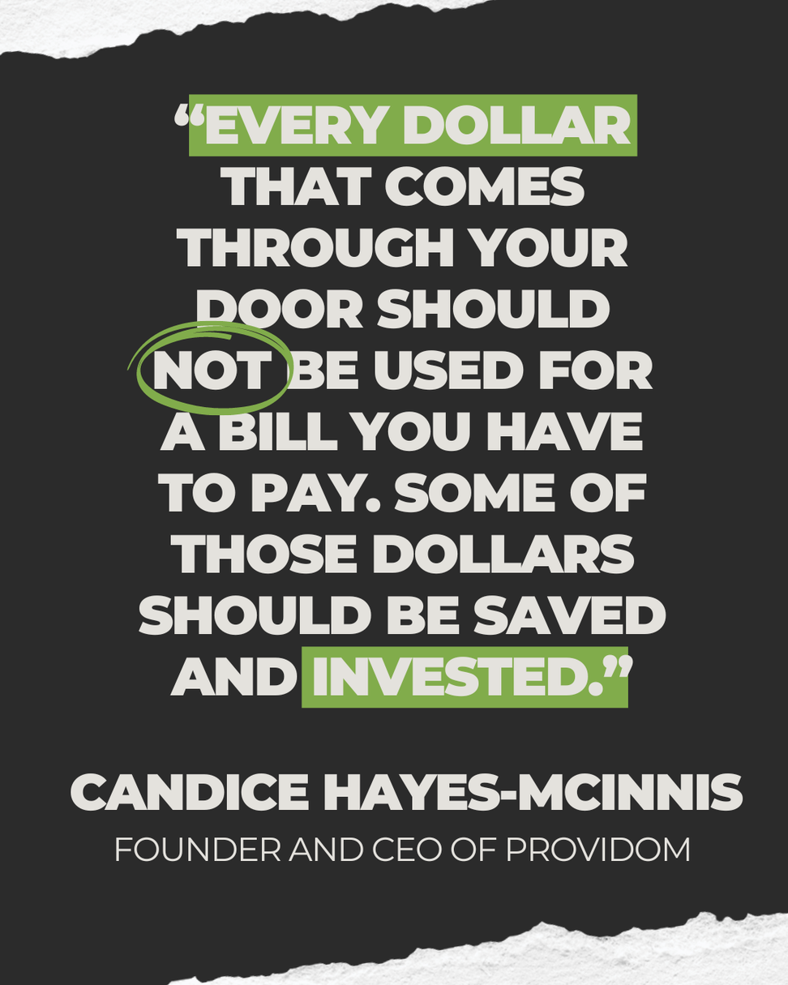

Slide 23
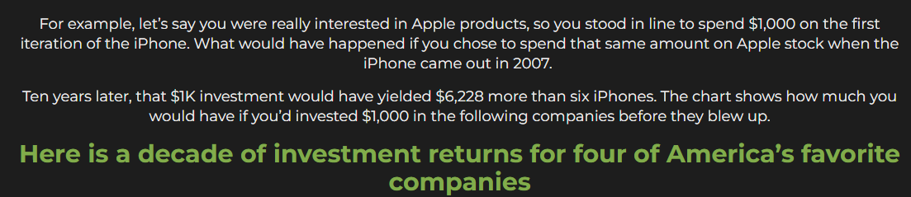
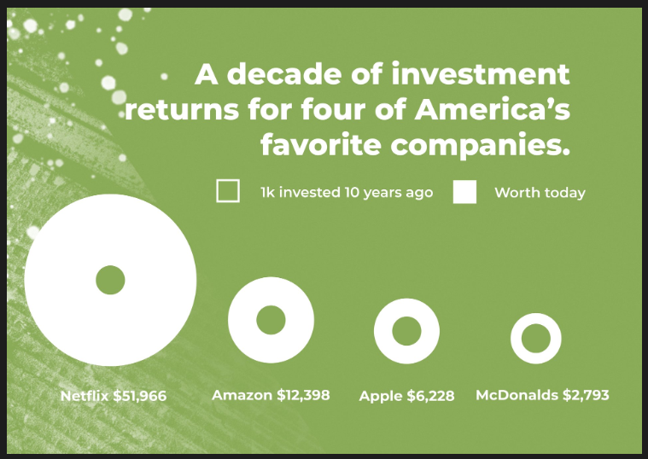

Slide 24


Slide 25


Slide 26
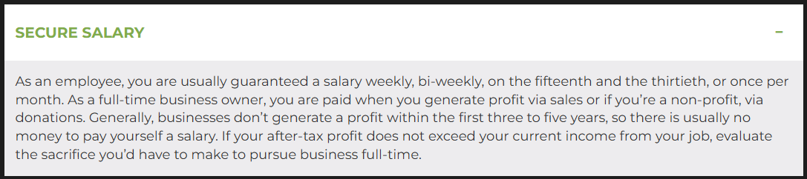

Slide 27
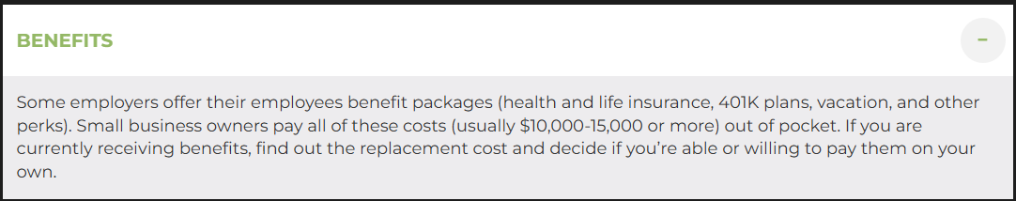

Slide 28
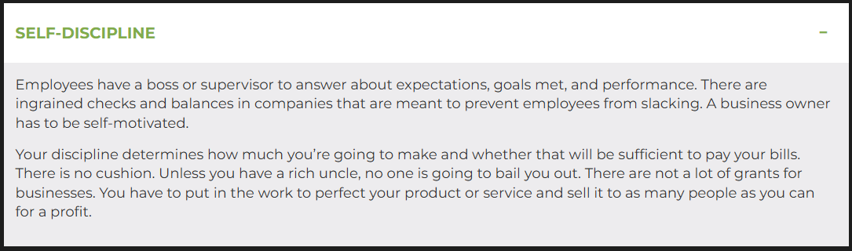

Slide 29
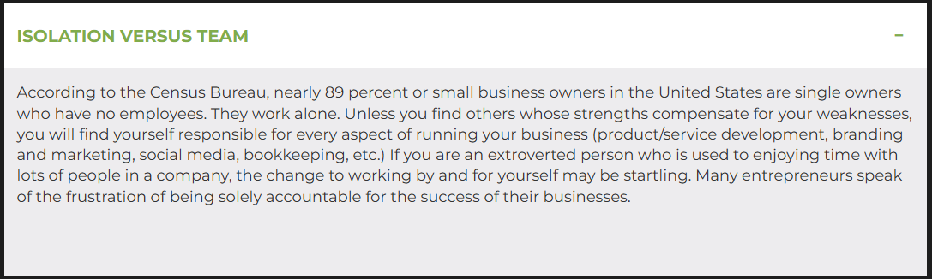

Slide 30
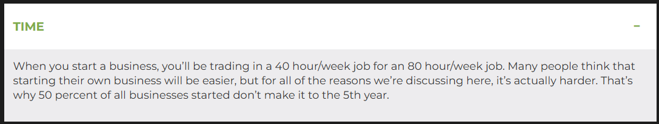

Slide 31
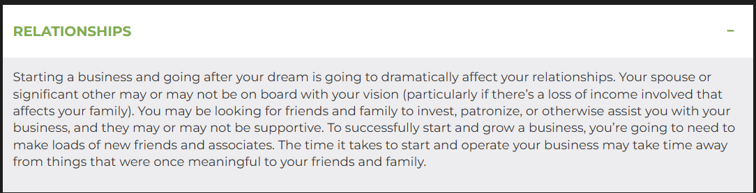

Slide 32
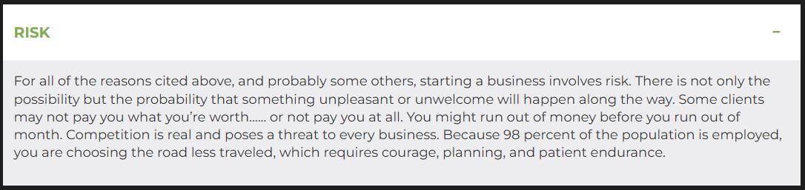

Slide 33
Survey
After considering your environment, background, and new information about credit, debt, or other important financial terms, what would you say are two specific things that keep you from handling money well?

Slide 34
Quiz
True or false: Some debt is “good” and essential to growing your business?
Choose only ONE best answer.
A
True
B
False
This answer is correct.
According to financial advisors, an emergency fund consists of how many months worth of expenses?
Choose only ONE best answer.
A
One-Two
B
Six-Nine
C
Three-Six
This answer is correct.
Panelist, Christine Luken, mention’s in this Lesson’s “The Studio” panel that [for some people] the easiest place to start when evaluating your financial situation is:
Choose only ONE best answer.
A
Credit Score
B
Spending
C
Debt
This answer is correct.

Slide 35
Survey
Create a cash flow plan!
Cash Flow Plan is about control. Money can make us crazy, but when we get out in front of our financial challenges and create a plan, that feeling of control eases the mental stress. Again, people call it a Cash Flow Plan because you are in control of where your currency flows. This is a simple concept: Take the amount of money you make every month and divide it up into expense categories.
For some expenses, like rent, you already know exactly how much money you need to spend each month. If you don’t know how much money to devote to undefined expenses, like food and entertainment, take a look at Every Dollar’s article titled “How to Determine Budget Percentages” and you can get an idea where to start.
Finish your Cash Flow plan by finishing the budget you started filling out earlier in the lesson.

Slide 36
Survey
Money management:
For the next week, keep a detailed log of every dollar you spend. Use the Spending Log to document your spending.

Slide 37
Survey
Masters business canvas and synopsis:
Write out your startup costs. This may be a guesstimate, but it will serve as somewhere to start as you continue to work on it.
Click here to download the Business Canvas and a sample Business Synopsis.
After you answer the questions under the “Costs” section, write it out in paragraph form to fill in that part of the Synopsis. See the sample Business Synopsis for an example.
Submit your assignment
You may only submit one file with maximum 100 MB in size

Slide 38


Slide 39


Slide 40


